Slide 1

PROJECT WORKFLOW
Open Science Student Support Group
Friday, Oct. 23 2020
ElizABETH Morin-Lessard
Image by Adam Douglas
©️ 2020 This work is licensed under a CC BY 4.0 license

Slide 2
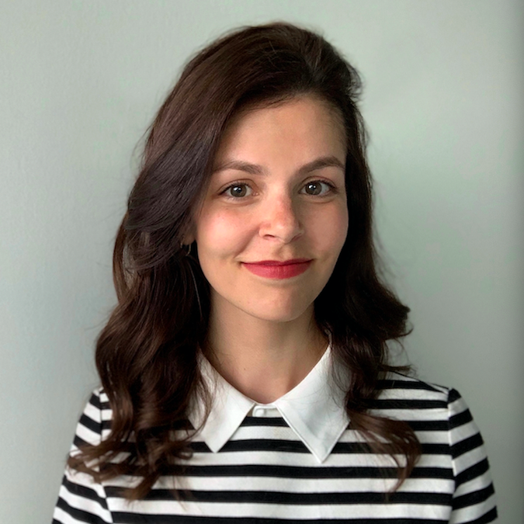

Elizabeth Morin-Lessard She/Her
Language and Cognitive Development Lab with Susan Graham; Language Development and Bilingualism
My motivation for talking to your Open Science group today is my belief that open science is cool because it’s a behaviour that fosters collaboration and discovery between researchers.
Open Science mirrors my meditation practice: It’s not an all-or-nothing approach.
My OSF profile: osf.io/vmiwg
Contact: Twitter elizabeth.morinlessa@ucalgary.ca

Slide 3
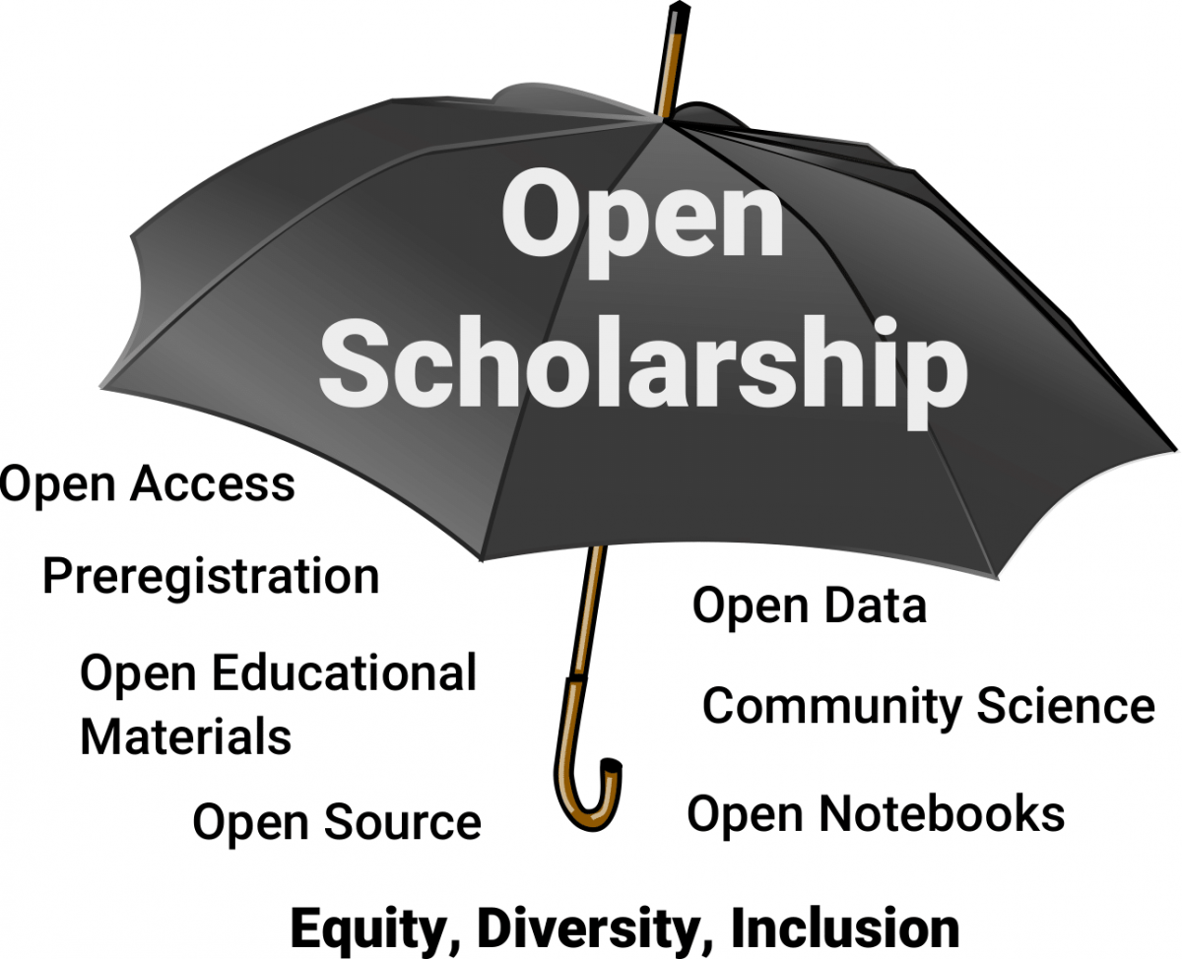
PROJECT WORKFLOW
Refers to all the steps that go into producing a tangible output.
Businesses do this all the time!
In research: Organize research projects, file structure, version control, reproducible code, cloud sharing, etc.
Helps you automate the way your work flows to make it easier for yourself and other researchers.
Image source

Slide 4
Best Practices: Examples
There are ‘Best Practices’ leading to enhanced project workflow that are generally accepted by the Open Science community (see Best Practices on OSF).
These practices are important when sharing your data or code (see Reproducibility Guide).
File management
Use consistent, simple, and descriptive names for your files.
data.csv or languagedata.csv is not ideal!
Use underscores instead of spaces (e.g., ‘data_studyname.csv’ vs. ‘data studyname.csv’).
Include README file or a data codebook (e.g. https://osf.io/b9fh8/ ).
Data management
Share only the data you want (e.g., a “clean” dataset).
Anonymize all data (e.g., remove testing date and identifying information).
Notes:
File management: using consistent names for these files is important for version control –(explain)
When sharing stimuli or code: E.g. in R, a reproducible example allows someone else to recreate your problem by just copying and pasting R code.
*For data management: File management guidelines also apply!

Slide 5
Importance
Why is having a good project workflow important?
You’re making your research process clear, transparent, and accessible to others.
A messy project workflow will make it difficult for others to follow what you’ve done and replicate your research findings.
Improving your workflow will make your research process more consistent.
Some labs and researchers may not have the same resources as you.
By sharing your workflow you can help science become what it should be, which is more accessible and less “elitist”.
Notes:
Resources: E.g. have an SPSS datafile that cannot be opened in other programs.

Slide 6
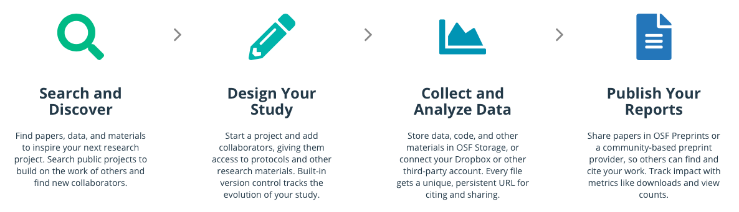
How does it work?
Project workflow is your plan of how you’re going to start from the discovery phase all the way to the publication phase of your research.
Step 1
Step 2
Step 3
Step 4
Image source: OSF
Notes:
There are many tools/practical steps participants can use to move towards implementing the practice.
Is your paper hidden behind a paywall?

Slide 7
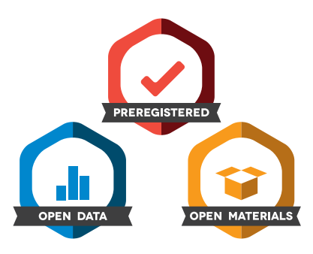
benefits
What are the benefits of this practice?
Transparency
Encourages collaboration and facilitates reproducibility
Makes your own work easier; Outlines small-scale and large-scale goals
Will save you time in the long run
Learning how to improve your research process; Increased efficiency
Gain recognition from the scientific community
Include links to OSF projects on your CV or in presentations, obtain open science badges.
Ultimately: You’re being a good researcher!
Image source

Slide 8
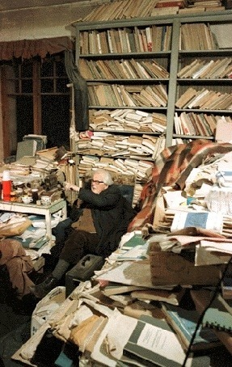
barriers
Establishing a good project workflow takes time!
But it will save you time downstream: Project organization is much easier to do ahead of time than post-hoc.
Barriers to project workflow:
More difficult for more junior academics
When researchers of all ages and stages share their workflow, others can learn from them and can help them improve their workflow
Harder for people who tend to be more disorganized
Can provide a “roadmap” of what you should be doing for current and future research projects
Jean Piaget in his office.
Image source

Slide 9

TIPS
Always start a research project with the mindset that you will share your materials and data with other researchers in the scientific community.
Don’t be scared to make mistakes!
We have all made some…
Mistakes happen, and boost learning.
Science will benefit from us making and finding those mistakes.
Image Source: Pexels

Slide 10
Challenges
Learn more about it!
Check out the resources on the next page!
Try it out!
Create an OSF account https://osf.io
Draft a workflow for your research (the more specific, the better!)
Talk about it!
Talk to your lab supervisor and collaborators about steps that you plan to take to improve your open science workflow (e.g., establish a lab workflow, naming conventions, stimuli/code sharing)
Implement it!
Next time you work on your research, find one thing that you can do to improve your workflow.

Slide 11
resources
Workflow vs. project management. https://www.projectcentral.com/blog/project-workflow-management/
How to define a workflow process. https://www.youtube.com/watch?v=FnuyET2HkPo
Professional Guides: Workflow Strategies (by GitHub) https://www.youtube.com/watch?v=aJnFGMclhU8
Easing into Open Science: A Tutorial for Graduate Students. https://psyarxiv.com/vzjdp/
Practical tips for data sharing (by some of my awesome colleagues) https://www.youtube.com/watch?v=QBYVCbv5ZiQ&t=5s
Learn about OSF: https://www.cos.io/products/osf

